Slide 1
Hough Transform
Performed after Edge Detection
It is a technique to isolate the curve of a given shape in a given image
Classical Hough Transform can locate regular curves like straight lines, circles, parabolas, ellipses, etc.
Requires that the curve be specified in some parametric form
Generalized Hough Transform can be used where a simple analytic description of feature is not possible

Slide 2
Given marked edge pixels, find examples of specific shapes
Line segments
Circles
Generalized shapes
Basic idea - Patented 1962
Every edge pixel is a point that votes for all shapes that pass through it.
Votes are collected in “parameter space” - look for peaks

Slide 3
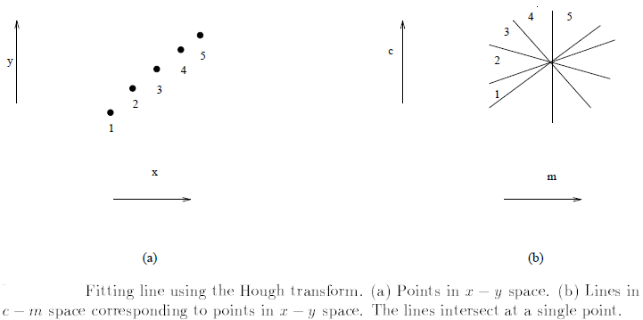
Straight Line
y = mx + c where m is the slope & c the y-intercept
The equation can be rewritten in c – m space as: c = -xm + y
Suppose we have several edge points (x₁, y₁), ..., (x_{n}, y_{n}) in x – y space that we want to fit in a line.
Each point in x – y space maps to a line in c – m space.

Slide 4
Properties in slope-intercept space
Each point (x_{i} , y_{i}) defines a line in the c − m space (parameter space).
Points lying on the same line in the x − y space, define lines in the parameter space which all intersect at the same point.
The coordinates of the point of intersection define the parameters of the line in the x − y space.

Slide 5
Algorithm
1. Quantize parameter space (c, m):
P [m_{min}, . . . , m_{max}] [c_{min}, . . . , c_{max}]
2. For each edge point (x, y)
For(m = m_{min}; m ≤ m_{max}; m++) {
c = − xm + y; /* round off if needed *
(P[m][c])++; /* voting */ }
3. Find local maxima in P[m][c]
if P[m][c] = M, then M points lie on the line y = m x + c

Slide 6
Find the equation for the edge for the following edge points
(2,2)
(4,7)
(5,5)
(6,2)
(6,6)
Let m_{min} = -2 & m_{max} = 2
c = -2m + 2
c = -4m + 7
c = -5m + 5
c = -6m + 2
c = -6m + 6
Notes:
m = 1, c = 0 so, y = x

Slide 7
(2,2)
(4, 7)
(6, 2)
(5,5)
(6,6)
m
c =
-
2m +
c =
-
4m +
c =
-
6m +
c =
-
5m +5
c =
-
6m +6
2
7
2
-
2
6
15
15
14
18
-
1
4
11
10
8
12
0
2
7
5
2
6
1
0
3
0
-
4
0
2
-
2
-
1
-
5
-
10
-
6
Point | Votes
(-2, 15) | 2
(0, 2) | 2
(1, 0) | 3
So, the equation becomes
y = x

Slide 8

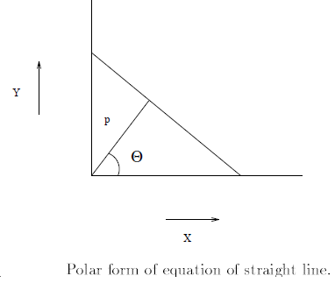
But there is a Problem
The slope of line parallel to y – axis is infinity, the computer can not handle it.
So, we follow another parameterization of a line
p = x cos θ + y sinθ

Slide 9
Algorithm
1. Quantize the parameter space (p, θ)
P[p_{min}, . . . , p_{max}][θ_{min}, . . . ,θ_{max}]
2. For each edge point (x, y)
For(θ = θ_{min}; θ ≤ θ_{max}; θ ++) {
p = x cos(θ) + y sin(θ) ; /* round off if needed *
(P[p][θ])++; /* voting */
}
3. Find local maxima in P[p][θ]

Slide 10
y
6
5
4
3
2
1
0
 | 0 | 1 | 2 | 3 | 4 | 5 | 6
Use Hough Transform to form the main edge.
Work with polar coordinates
x
p = x cos θ + y sinθ
Edgels – (0,5), (1,4), (3,2), (3,3), (5,0)

Slide 11
For each point use the equation.
p = x cos θ + y sinθ
p = 0 cos θ + 5 sin θ (0,5)
p = 1 cos θ + 4 sin θ (1,4)
p = 3 cos θ + 2 sin θ (3,2)
p = 3 cos θ + 3 sin θ (3,3)
p = 5 cos θ + 0 sin θ (5,0)

Slide 12
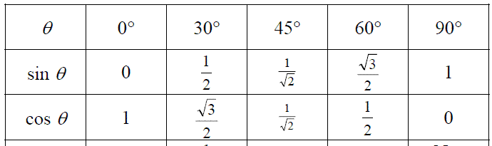
 | 0 cos θ + 5 sin θ | 1 cos θ + 4 sin θ | 3 cos θ + 2 sin θ | 3 cos θ + 3 sin θ | 5 cos θ + 0 sin θ
0 | 0 | 1 | 3 | 3 | 5
30 | 2.5 | 2.9 | 3.9 | 4 | 4.3
45 | 3.5 | 3.5 | 3.5 | 4.2 | 3.5
60 | 4.3 | 3.9 | 3.2 | 4 | 2.5
90 | 5 | 4 | 2 | 3 | 0

Slide 13
In the given question, the curve corresponding to the point (3,3) does not intersect at the common point (3.5, 45), where the other curves meet.
The equation for the edge will be:
3.5 = x cos 45 + y sin 45

